Slide 1
Automated Testing
QACAT – Automated Testing

Slide 2
What is Software Testing?
“Software testing is a process used to identify the correctness, completeness and quality of developed computer software. It includes a set of activities conducted with intent of finding errors in software so that it can be corrected before the product is released to the end users.”
In simple words: software testing is a process to establish and remove flaws within a software system.

Slide 3
Types of Software Testing
Functional
Non-Functional
Maintenance
Unit testing
Integration testing
Smoke testing
User acceptance testing
Performance
Scalability
Usability
Others ending in –ity
Regression
Maintenance

Slide 4

Exercise
Given a scenario - moving a file from folder A to folder B, think of all of the possible ways to test this on what could go wrong

Slide 5
Potential Scenarios
Trying to move the file when it is Open
You do not have the security rights to paste the file in Folder B
Folder B is on a shared drive and storage capacity is full.
Folder B already has a file with the same name, in fact the list is endless
Or suppose you have 15 input fields to test ,each having 5 possible values , the number of combinations to be tested would be 5^15
If you were to test the entire possible combinations project EXECUTION TIME & COSTS would rise exponentially. We need certain principles and strategies to optimize the testing effort

Slide 6
The 7 Testing Principles
Exhaustive testing is not possible
Defect clustering
Pesticide paradox
Testing shows presence of defects
Absence of error
Early testing
Testing is context dependent

Slide 7
Exhaustive testing is not possible
We can’t possibly do 30 billion tests to cover all of the potential scenarios there are. Therefore we focus on the optimal amount based on the risk assessment of the application.
How do we determine the risks? Is a million dollar question…
Given a scenario to test: what operation is most likely to cause a fail in an operating system?
Best guess would be opening 20 windows at the same time or running PUBG. Which would then lead to multi-tasking activity to be our main focus of testing, which leads to the next principle.
Notes:
PUBG – player unknown battlegrounds (not optimised, plenty of bugs, freezes all the time) – this is Tadas, don’t ask me.

Slide 8
Defect clustering
States that a small number of modules contain most of the defect detected.
According to the application of Pareto Principle: 80% of problems are found in the 20% of the modules.
With accumulation of experience you will be able to identify these early on.
The problem: with the accumulation of tests that will be repeatedly ran, eventually the same test cases will not find new bugs.
Notes:
Pareto principle – 80% of the issues arise from 20% of the causes.

Slide 9
Pesticide paradox
Repetitive use of the same pesticide will lead to the development in immunity, becoming ineffective. Same principle applies to testing, where the same repetitive tests won’t be able to find new defects.
The medicine: test cases need to be regularly review and revised, adding new and different test cases to help find more defects.
Can’t depend on existing testing techniques, testers have to improve continuously in order to make tests more effective.
At the end of the day, you can’t claim a product to be 100% bug free.

Slide 10
Testing shows presence of defects
Testing talks about the presence of defects and don’t talk about the absence of defects. i.e. Software Testing reduces the probability of undiscovered defects remaining in the software but even if no defects are found, it is not a proof of correctness.
But what if , you work extra hard , taking all precautions & make your software product 99% bug-free. And the software does not meet the needs & requirements of the clients.
This leads us to our next principle, which states that- Absence of Error

Slide 11
Absence of Error
If the software is 99% error free but is still unusable is a potential possibility. Why could this be?

Slide 12
Absence of Error
If the software is 99% error free but is still unusable is a potential possibility. Why could this be?
If testing was done thoroughly but for the wrong requirement.
Testing is not all about finding defects, it’s also about checking that the software addresses the business needs. Therefore absence of error is a fallacy i.e Finding and fixing defects does not help if the system build is unusable and does not fulfill the user's needs & requirements.
Which leads us to the next principle.

Slide 13
Early Testing
As the name implies, testing should start as soon as possible in the software development life cycle.
This will:
Defects will be captured in the early stages like requirements or design phase, which are the early stages
Much cheaper to fix issues in early stages compared to the end of development
How early should you start testing? As soon as the requirements are defined.

Slide 14
Testing is context dependent
Applications are never the same, therefore you wouldn’t do the same testing for both an ATM and online banking application…

Slide 15
So why do we automate testing?
There are lots of reasons as to why we would automate tests, the main reasons is for repeatability.
By automating tests we can run the test whenever a change has been made to the system that we are testing.

Slide 16
Why is testing important?
Studies show that around 90% of investment in software involves the maintenance of code after the initial “project” is complete.
Regression testing is very important for maintenance.
This means that there is a high demand for good testers.

Slide 17
JUnit
OVerview
Notes:
Manual testing – this is you using your code and seeing if it is working
Can become a tedious process if you are using a self built interface
The point of it is when you are developing a program you want to be able to build a test for this piece of functionality to prove that it works.
In development when we change one thing we can break things elsewhere in the system
Fail fast – as soon as something you have immediate feedback that something has failed
Tests have quite a few different aspects
Improve the quality of code by finding defects / bugs
Building confidence in the program – prove that your product works – the client will want to see that the system with a fully fledged test suite that covers 80% of your code – 80% of the code is touched by tests
How we accomplish this is really simple, its an external library that gives us some nice output.

Slide 18
JUnit with Maven (part 1)
Open Eclipse
File > New > Other
Expand “Maven” folder
Select “Maven project”
Specify where you want your project saved and Next
Select archetype I’d say go for the “maven-archetype-quickstart”
Group Id is conventionally “com.qa.quickstart” or something similar
Specify Group Id/Artifact Id
New project will be created and added to the project explorer on the left side menu

Slide 19
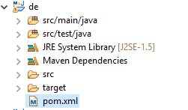
Junit with Maven (Part 2)
Depending on the naming of artifactId you used, the root project will be called something different than “De”

Slide 20
JUnit with Maven (part 3)
Open “pom.xml”
By default it will open up in the “Overview” view, you want to change it to the “pom.xml” view, you can do it at the bottom of eclipse window
Next you will see inside the pom file that there will be the ArtifactId, GroupId and the rest of the things, what we’re interested is the dependencies part of the pom file
You can should see that there are two pairs of tags that are used to add dependencies, one is the parent tag called “dependencies” which is basically a collection of dependencies for the project. Inside of the “dependencies” we have the child tags that are used for a single dependency we want to add so if we wanted to have multiple dependencies we would have more than one pair of “dependency” tags. We see that there is already added a dependency for Junit, which act’s as a good example on how it should be done.

Slide 21
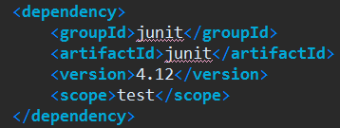
Junit with Maven (Part 4)
This is the dependency and version number that is required for JUnit.

Slide 22
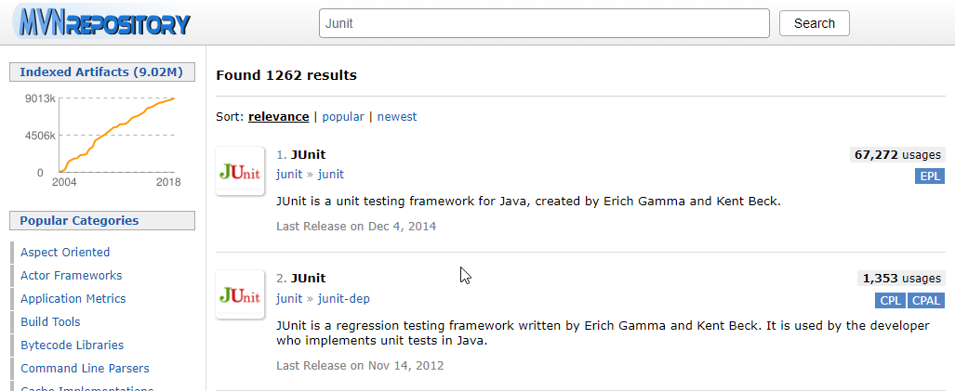
Junit with Maven (Part 5)
We can get most of the dependencies from https://mvnrepository.com/ if we were to search for Junit using the search bar at the top of the page, you would see the results for what libraries were found, we want the JUnit one which is the first result

Slide 23
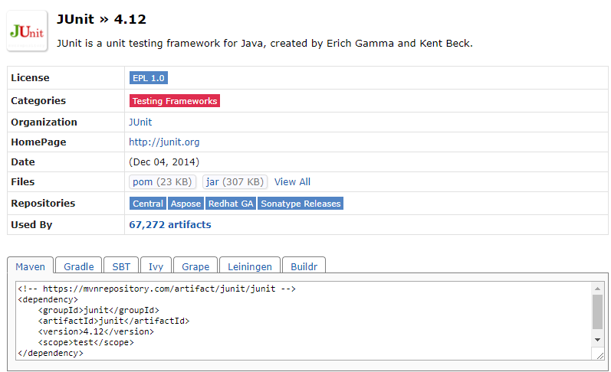
Junit with Maven (Part 6)
Next we select the version that we want to use…

Slide 24
JUnit with Maven (Part 7)
At the bottom you should see the Maven tab selected and a dependency inside of it
We would copy this dependency and add it to inside the “dependencies” tags and then it would become a dependency for our project
You can similarly find all sorts of dependencies you might need using this method, for example Selenium or Apache POI.

Slide 25
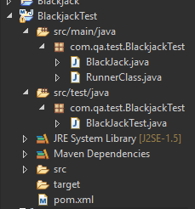
Setting up JUnit
Next thing that we need to do is to create a new Junit test – similar to how you have been creating Java classes within Eclipse.
Conventionally this is done in the src/test/java folder.
To do this, Right-click the folder > new > Class, and then specify the name for the class.

Slide 26
Setting up Junit (cont.)
This code on the right is similar to what Eclipse will auto-generate for you.
Import static org.junit.Assert.* allows us to use all the methods (e.g. AssertEquals) from the Junit.Assert Library. The import org.junit.Test allows us to use the @Test annotation
Here we are creating a test for the BlackJack Exercise you completed earlier, the first test, BlackJackTest, is set to fail by default.
package Test;
import static org.junit.Assert.*;
import org.junit.Test;
public class BlackJackTest {
@Test
public void test() {
fail("Not yet implemented");
}
}

Slide 27
Setting up Junit (cont.)
Now we can populate our test with ‘assert’ statements.
These statements checks an expected value against the actual returned value of a method that we call.
@Test
public void test() {
BlackJack blackjack = new BlackJack();
assertEquals(10, blackjack.play(10, 22));
assertEquals(9, blackjack.play(22, 9));
assertEquals(0, blackjack.play(22, 22));
assertEquals(10, blackjack.play(10, 7));
assertEquals(19, blackjack.play(1, 19));
}

Slide 28
Setting up Junit (cont.)
@Test
public void test() {
BlackJack blackjack = new BlackJack();
assertEquals(10, blackjack.play(10, 22));
assertEquals(9, blackjack.play(22, 9));
assertEquals(0, blackjack.play(22, 22));
assertEquals(10, blackjack.play(10, 7));
assertEquals(19, blackjack.play(1, 19));
}
System.out.println(blackjack.play(10, 22));
System.out.println(blackjack.play(22, 9));
System.out.println(blackjack.play(22, 22));
System.out.println(blackjack.play(10, 7));
System.out.println(blackjack.play(1, 19));

Slide 29
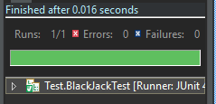
Setting up Junit (cont.)
The previous slide showed how we may have ‘tested’ our code in that past, by visually checking the output of the methods versus what we expect it to be.
In Eclipse we run our tests the same way as we run our code.
With Junit, when the tests have been run we get a green bar to tell us that the tests have passed.
Visually this is easier to comprehend and also helps keep our code tidy.

Slide 30
JUnit – Annotations
@BeforeClass – Executes before any of the tests
@AfterClass – Executes after all of the tests.
@Before – Executes before a test
@After – Executes after a test
@Test – Signifies that the method is a test
@Ignore – Signifies to ignore the test.
@Runwith – Signifies Junit to use that class instead of the default Runner class
@Parameters – Signifies the parameter dataset to use for the test(s)
@Category – Used to add meta data for a test
@IncludeCategory – Used to include tests with specific metadata
@ExcludeCategory – Used to exclude tests with specific metadata
Notes:
Might not have seen these before possible @Override
Before a method or a variable
@BeforeClass
- symblifys when the test should be run
They are not run from the Main method
Tests are effectively a standalone file that is run separately
First 6 are quite important
Lot of control of our test suite when it does what
You may be preparing your scenario
Or resetting your data – cleaning out your data

Slide 31
@Test
Signifies the method is a test to be run.
A timeout can be added, forcing it to fail if it doesn’t finish in a certain period.
Expected Exceptions can be added, allowing the test to pass if an exception is thrown.
// fail
@Test
public void test1() {
fail("Fail");
}
// fail
@Test(timeout = 1000)
public void test2() {
try {
Thread.sleep(2000);
} catch (InterruptedException e) {
e.printStackTrace();
}
}
// pass
@Test(expected = ArithmeticException.class)
public void test3() {
throw new ArithmeticException();
}

Slide 32
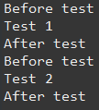
Order of Execution
@Before
public void method2() {
System.out.println("Before test");
}
@Test
public void method3() {
System.out.println("Test 1");
}
@Test
public void method4() {
System.out.println("Test 2");
}
@After
public void method6() {
System.out.println("After test");
}
@Before – Executes before a test
@After – Executes after a test
We use @Before to set up each test that we are running, as this is executed before every test, if every test requires the same setup this can minimise the amount of code we write.
We use @After to ‘tear down’ the environment in which our test is being run. Effectively we can use this to create a ‘clean slate’ for the rest of our tests.
Notes:
The ordering does not matter
This is the output
Explain the output

Slide 33
Order of Execution
@BeforeClass
public static void method1() {
System.out.println("Before class");
}
@Test
public void method3() {
System.out.println("Test 1");
}
@Test
public void method4() {
System.out.println("Test 2");
}
@AfterClass
public static void method7() {
System.out.println("After class");
}
@BeforeClass – Executes before any of the tests
@AfterClass – Executes after all of the tests.
Typically we use @BeforeClass to set up our testing environments in some way. For example when using Selenium we could set up our driver here.
@AfterClass is used to close down any streams that we may have created during the execution of our tests.
Notes:
The ordering does not matter
This is the output
Explain the output

Slide 34
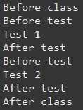
Order of Execution
@BeforeClass
public static void method1() {
System.out.println("Before class");
}
@Before
public void method2() {
System.out.println("Before test");
}
@Test
public void method3() {
System.out.println("Test 1");
}
@Test
public void method4() {
System.out.println("Test 2");
}
@After
public void method6() {
System.out.println("After test");
}
@AfterClass
public static void method7() {
System.out.println("After class");
}

Slide 35

Order of Execution
@Before
public void method2() {
System.out.println("Before test");
}
@Test
@Ignore
public void method3() {
System.out.println("Test 1");
}
@Test
public void method4() {
System.out.println("Test 2");
}
@After
public void method6() {
System.out.println("After test");
}
@Ignore can be used to ‘skip’ a test.
If you don’t want a particular test to be ran every time then by putting @Ignore will cause the implementation to be ignored.
Notes:
The ordering does not matter
This is the output
Explain the output

Slide 36
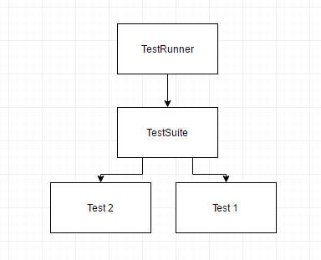
Test Suites
Comprised of three parts:
Test Suite class
Test Runner class
Test classes
Test runner classes runs the tests references from the test suite.
Test suite class references the test classes.
Test classes contain the tests to be run.

Slide 37
Parameterisation
@RunWith(Parameterized.class)
public class ExampleTest {
@Parameters
public static Collection<Object[]> data() {
return Arrays.asList(new Object[][]{{0, 0}, {1, 1}, {2, 1}, {3, 2},{4, 3}, {5, 5}, {6, 8}});
}
private int intPut;
private int intPected;
// @Parameter // first data value (0) is default
// public /* NOT private */ int fInput;
//
// @Parameter(1)
// public /* NOT private */ int fExpected;
public ExampleTest(int input, int expected) {
intPut = input;
intPected = expected;
}
@Test
public void test() {
assertEquals(intPected, Fibonacci.compute(intPut));
}
}
The ability to run a test against a data set.
Good to find potential bugs in code.

Slide 38
Categorization
The ability to add meta data to a test.
Useful to organise certain tests
Unit Tests
Integration Tests
Slow Tests
Fast Tests
Unstable Tests
@Category(X.Class)
@IncludeCategory(X.Class)
@ExcludeCategory(X.Class)
@SuiteClasses({Test1.Class, Test2.Class})
@RunWith(Categories.Class)
Notes:
Will have a lot of tests
Some fast some slow
You may want to categorise
You wont need to do this for these small projects
@RunWith is used by a runner class, runner classes are used for running test classes.
For example you may see some examples of running a Cucumber Feature file using a runner class.

Slide 39
JUnit Test Methods
assertTrue(“Boolean was False”, Boolean)
assertFalse(“Boolean was True”, Boolean)
assertEquals(“Actual was not Expected”, Expected, Actual)
assertEquals(“Actual was not expected within the Tolerance”, Expected, Actual, Tolerance)
fail(“Method Failed the Test”)
assertNull(“The object is not Null”, Object)
assertNotNull(“The object is Null”, Object)
assertSame(“The objects are not the same”, Expected, Actual)
assertNotSame(“The objects not the same”, Expected, Actual)
Notes:
http://junit.sourceforge.net/javadoc/org/junit/Assert.html
Special functions for Junit
We pass it a message that it will output if the , and we give it a Boolean
assertEquals is used a lot – we are checking if the thing that is given back is the expected result
Theoretically you could use this for everything
No one expects you to use all of them
But there are 200 that exists

Slide 40
JUnit Test Methods
It is not expected for you to remember all of these.
assertEquals(“Actual was not Expected”, Expected, Actual)
Is very flexible, ensure you include the opening String in your assert statement for best practice.
Notes:
http://junit.sourceforge.net/javadoc/org/junit/Assert.html
Special functions for Junit
We pass it a message that it will output if the , and we give it a Boolean
assertEquals is used a lot – we are checking if the thing that is given back is the expected result
Theoretically you could use this for everything
No one expects you to use all of them
But there are 200 that exists

Slide 41
JUnit - @Test Example
import static org.junit.Assert.*;
import org.junit.Test;
public class AuthorTest {
@Test
public void testAuthor() {
Author testing = new Author();
assertNull(testing.getName());
}
@Test
public void testAuthorString() {
Author testing = new Author("a");
assertNotNull(testing.getName());
}
@Test
public void testSetName() {
Author testing = new Author();
testing.setName("a");
assertEquals("a", testing.getName());
}
}
class Author {
String name;
Author() { }
Author(String name) {
this.name = name;
}
public void setName(String name) {
this.name = name;
}
public String getName() {
return name;
}
}

Slide 42
Katalon Automation Recorder

Slide 43
What is Katalon Automation Recorder?
Katalon Automation Recorder is a plugin for Chrome that allows you to record your actions and replay them.
It is mainly used for short actions that are repeatable and where the data stays the same.
Intended to be a rapid Prototyping tool, for advanced tests, they should be exported into a project and finished using WebDriver

Slide 44
Setting up
Using the latest version of Chrome
Search for Katalon Automated Recorder and follow the links to download the Plug-In
You do not need to sign-up and download Katalon Studio

Slide 45
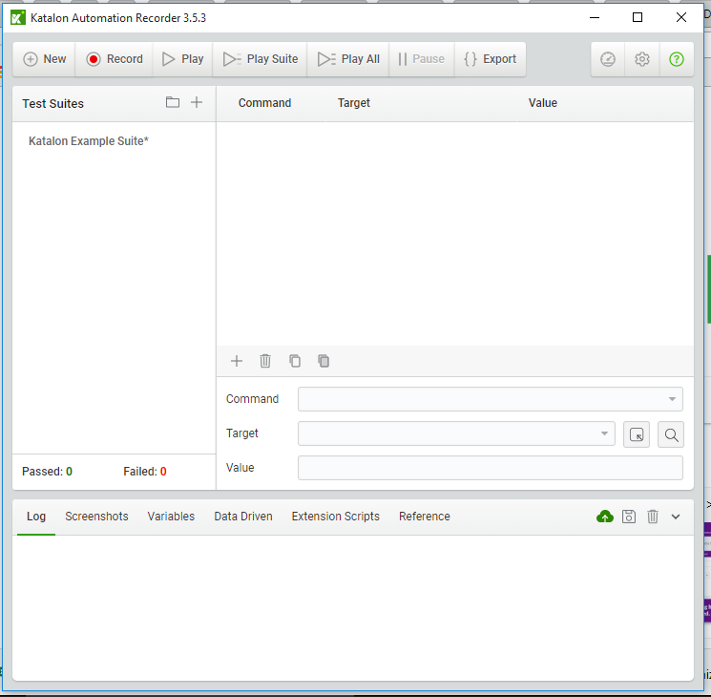
Using Katalon Automation Recorder
Play Test(s)
Recording Status
Export
Test List
Test Commands

Slide 46
Common Commands
Command | Explanation
Type | Sets the value of an input field, as though you typed it in.
Open | Opens a page using a URL
clickAndWait | Clicks on a link, button, checkbox or radioButton, if that click action triggers a lod event, it will then call waitForPageToLoad
Select | Selects an option from a drop-down using an option locator
selectFrame | Selects a frame within the current window
Verify/AssertTitle | Verifies that the title of the page matches the value given
verifyTextPresent | Verifies that the specified text pattern appears somewhere in the rendered page
verifyElementPresent | Verifies that the specified element is somewhere on the page
waitForPageToLoad | Waits for the page to load, this is called after any command postfixed with andWait
waitForElementPresent | Waits a specified/default amount of time for an element to appear on the page
waitForTextPresent | Waits a specified/default amount of time for expected text to appear on the page.
waitForTextNotPresent | Waits a specified/default amount of time for expected text to disappear from the page.

Slide 47
The Difference between Verify and assert
Assert and Verify commands exist for the same areas, such as assertTitle and verifyTitle
If an assert fails, the test stops.
If a verify fails, the test continues but logs the failure.
waitFor is similar to assert in that it will fail if it doesn’t become true within the timeout period.
Loading pages Example
Assert that the page has loaded
Verify that a button has appeared
Click the button
Assert that the next page has loaded
Verify that certain elements have appeared

Slide 48
The Difference between Verify and assert
Verify does not come from JUnit, therefore, for now, it can only be used within the Katalon Automatic Recorder.
A Websearch will show you other libraries that can make use of Verify.

Slide 49
Using Katalon Automatic Recorder
Once you have started the Recorder, manually execute the process you wish to test.
When the process is completed, right-click and select the Recorder.
Choose an assert or verify statement to check a particular condition, and to complete the test.
Katalon can help you devise a structure for your tests when other methods fail.

Slide 50
Selenium WebDriver

Slide 51
Using WebDriver
Create a new Maven Project
Add the Selenium-Java Dependency to the POM.xml
Update the current JUnit to be 4.12
Create a class within the test folder
Add a test to this class using the @Test annotation.

Slide 52

Adding WebDriver
For each web browser that you want to test you need to do two things:
Download the appropriate driver
Set the system path to that drivers location within your IDE. To do this the first thing you must do is setProperty.
Finally you need to instantiate a new ChromeDriver or FireFoxDriver.
(Chrome example)
System.setProperty("webdriver.chrome.driver","C:\\filepath\\chromedriver.exe");
(FireFox example)
System.setProperty("webdriver.gecko.driver", "C:\\filepath\\geckodriver.exe");

Slide 53
Creating a test with WebDriver
A Selenium test usually is made up of three methods:
A before method
A test method
An after method

Slide 54
@Before Method
Usually called setup() as it is meant to be for creating your WebDriver
It is also a place to put anything else you wish to create that is only used for each test. For example, setting up a report or logger to track the test
You can only ever make one of these methods.
This method will run before every @Test.

Slide 55
@Test Method
This method is where your test code goes.
If your test is more complex then a few actions then it may be best to move it into a different class and call it from this method
The final line of this method is usually your assert
There is no limit on how many test methods you can have

Slide 56
@After Method
Usually called tearDown() as you are cleaning up after your code has finished
This is where you should quit your WebDriver to stop processes staying around after your test has finished. i.e. stopping your computer crashing after running tests several times.
You can only ever make one of these methods

Slide 57
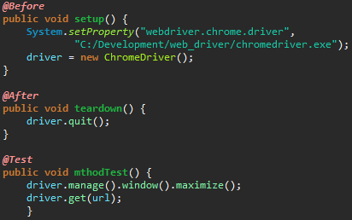
Basic WebDriver Example

Slide 58
Finding Elements
Now we know how to set up a selenium test it is time to look at how we get elements from the page to interact with.
To find elements with Selenium we use things called selectors.
There are multiple types of Selectors that all have their pros and cons to using them

Slide 59
Selectors
Method Call | Description
By.name(String) | Find elements based on their name
By.id(String) | Find elements based on their ID
By.className(String) | Fid elements based on the value of the class attribute
By.linkText(String | Find elements based on their linktext
By.XPath(String) | Find elements using xpath
By.CSSSelector(String) | Find elements via their css
By.partialLinkText(String) | Find elements that contain the given link text
By.tagName | Find elements via their tag name.
Usually the best Selectors to use would be:
ID
CSS/Xpath
Class name
Name
Link Text
Tag name
Partial Link text

Slide 60
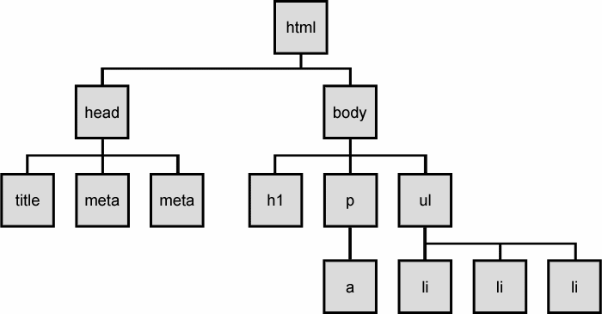
Document Object Model

Slide 61
Using WebDriver

Slide 62
Common Commands
Command | Outcome
Webdriver.get() | It will tell Selenium to go to a specific url. The url must contain http:// or https://
Webdriver.findElement(By.) | It will tell Selenium to find an element from the dom with a certain selector
Webdriver.findElements(By.) | It will tell Selenium to find all the elements from the dom with a certain selector
.click() | This will tell Selenium to click the element
.sendKeys() | This will tell Selenium to input the string into an element
isDisplayed() | This will ask Selenium if the element is current visible/displayed on the screen
.getAttribute() | This will ask Selenium to retrun the attribute of an element

Slide 63

End Result
If we are using FindElement to access an element and then manipulate it we use.
If you are using FindElement to access an element, assign it to a WebElement Variable, and then manipulate it, we can use.

Slide 64
submit()
It can ONLY be used on the following elements
Form Elements
Elements within a Form Element
It will throw a NoSuchElementException() if it’s executed on an element that isn’t within a form.
WebElement goButton = driver.findElement(By.id("btnID"));
goButton.submit();

Slide 65
Analysing Elements
getAttribute() is a method that can be executed on all webelements.
It will search for the attribute that you input and return a string which contains the value of the attribute if found.
WebElement searchBtn = driver.findElement(By.name("btnK"));
System.out.println("Name: " + searchBtn.getAttribute("name"));
System.out.println("Id: " + searchBtn.getAttribute("id"));
System.out.println("Class: “ + searchBtn.getAttribute("class"));
System.out.println("Label: “ + searchBtn.getAttribute("aria-label"));

Slide 66

sendKeys()
driver.get("http://www.google.com");
WebElement searchBox = driver.findElement(By.name("q"));
searchBox.sendKeys(Keys.chord(Keys.SHIFT, "qa consulting"));
Another very commonly used command.
Can be used on the following:
Textbox elements
Textarea elements
Void sendKeys(CharSequence)
It types the text exactly how a user would.
Keys provides a set of inputs that a keyboard generally provides such as Keys.Shift, simulating the user pressing the shift key.
Keys also provides a function called Chord which lets you group key commands together.

Slide 67
getLocation()
Can be executed on all elements.
Returns a Point object.
Good for testing if elements that are loaded/moved on events.
// An element
WebElement doesExist = driver.findElement(By.xpath("//*[@id=\"bigCookie\"]"));
// calling the getLocation() method and assigning it to a Point object
Point firstPoint = doesExist.getLocation();
// getting the x attribute of the Point Object
Int firstX = firstPoint.x;

Slide 68
getSize()
Can be executed on any visible component
Returns a Dimension object
Good for testing elements that change size upon an event.
// An element
WebElement doesExist = driver.findElement(By.xpath("//*[@id=\"bigCookie\"]"));
// calling the getSize() method and assigning it to a Dimension object
Dimension firstDimension = doesExist.getSize();
// getting the x attribute of the Dimension Object
Int firstX = firstDimension.x;

Slide 69
Miscellaneous Commands
Method Signature | Description
String getText() | Can be used on all web elements. Returns the visible text on the element, or nothing if there is none.
String getTagName() | Can be used on all web elements. Returns the tag name of the element.
Boolean isDisplayed() | Can be used on all web elements. Returns if the element is visible on the web page.
Boolean isEnabled() | Can be used on all web elements. Returns if the element is enabled on the web page.
Boolean isSelected() | Can be used on radio buttons, options in select boxes and checkboxes. If executed on any other web element it will return false. Returns if an element is selected right now on the web page.

Slide 70
Design Considerations

Slide 71
Design Patterns
Some well used ones include:
POM – Page Object Model
Façade
Singleton
Observer
You can also use:
Strategy Design
Chain of Responsibility

Slide 72
Page Object Model
Each WebPage has its own class
Each class has all the necessary WebElements defined
Each class has all the necessary functionality defined via methods
Reusable WebElements
Reduces time updating scripts.
Object Repository – this refers to the
elements that are being stored in the class.

Slide 73
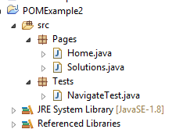
Page Object Model – Version 2 – Page Factory
InBuilt POM concept for Selenium WebDriver
Utilises the @FindBy annotation
Accepts all normal locator strategies
Utilises the PageFactory.initElements() method.

Slide 74
Page Factory - Ajax
Key advantage of Page Factory is the ability to use AjaxElementLocatorFactory
Works with lazy loading
AjaxElementLocatorFactory factory = new AjaxElementLocatorFactory(driver,100);

Slide 75
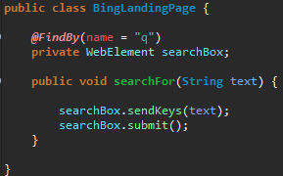
Page Factory Example

Slide 76
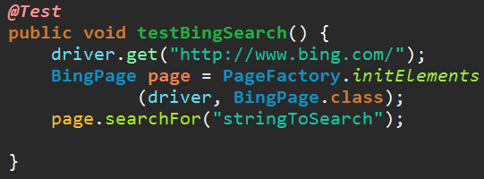
Page Factory Example

Slide 77
What should I test?
User expectations?
Time allowed?
Priorities set by PM?

Slide 78
Testing Static Content
Also known as a Content Test
Simple test for the existence of a static element.
Examples
Title
Images
Footer
Headers
Link Tests also come under the same category.

Slide 79
Function Tests
Requires some user input
Returns some output.
Often will involve multiple pages with form based input with multiple response pages.
Often the most complex tests, but most important to automate.
Common functional tests include Login, Registration, user account operations etc.
Generally mirror user scenarios

Slide 80
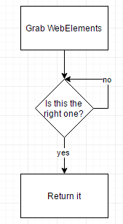
Testing Dynamic Content
Elements that have dynamically generated locators
findElements()
Grab all the elements under a certain tag.
Iterate through them until you find what you’re looking for
Return it.
checkbox_123_482F12_x1983

Slide 81
Locating Ajax Elements
public boolean isElementPresent(By locator) {
try {
driver.findElement(locator);
return true;
} catch (NoSuchElementException e) {
return false;
}
}
Ajax elements don’t load instantly, so you need to write a few methods to wait for them to appear.
for (int seconds = 0; seconds < 60; seconds++) {
if (isElementPresent(By.linkText("ajaxLink")))
break;
}
Thread.sleep(1000);
}
}

Slide 82
Wrapping Selenium Calls
public void safeClick(String elementLocator) {
if (isElementPresent(elementLocator)) {
driver.findElement(elementLocator).click();
} else {
System.out.println("Not available to be clicked!");
}
}
Often you will call the same couple of functions together.
If so, wrap them into one method!
Similarly, you should created wrapper “safe” methods.
public void clickAndWait(String elementLocator, String waitPeriod) {
driver.click(elementLocator);
driver.wait(waitPeriod);
}

Slide 83
Location Strategies
Whilst we can select elements via Id, className, name, tag, xpath etc.
What are the tradeoffs of each type?
Id is the most efficient in terms of test performance
Xpath take a long time to process in relation to CSS
linkText is fast but limited to just links, and also prone to change.

Slide 84
Cross Browser Testing

Slide 85
What is Cross browser testing?
Functional Test
Used to check if X feature works on multiple browsers.
Common issues include
Font size mismatch
JS Implementation
CSS/HTML Validation
Browsers not supporting X
Page alignment/div size
Image orientation
Incompatibility with OS

Slide 86
What other browsers can I test?
Firefox
Internet Explorer
Internet Edge

Slide 87
Actions

Slide 88
Actions
We have been working to emulate all tasks a potential user of our system might make.
But how can we automate keystrokes direct to the browser?
How can we automate mouse Movement?

Slide 89
Actions
Actions are a way of saving a sequence of events on one or multiple elements to then be executed.
One example would be trying to select multiple elements on a page, such as a list, often using the CTRL modifier whilst clicking them.

Slide 90

ActionBuilder – Mouse Interactions
moveByOffset() – Used to move the mouse from its current position to another point on the web page.
When a page is loaded, the initial position is usually 0,0 unless the page has an explicit focus call.
Public Actions moveByOffset(int xOffset, int yOffset)
For X, A positive value will move the mouse to the right, whilst a negative will move it to the left.
For Y, A positive value will move the mouse downwards, whilst a negative will move it upwards.

Slide 91
ActionBuilder – .perform()
The .perform() method is our way of executing the actions that we have specified

Slide 92
WebDriver – Mouse interactions, Why?
Mouse interactions shouldn’t be necessary the majority of the time.
If everything has a unique identifier (id, classname, name, etc.) You shouldn’t need to manually position the mouse over it.
Alternatively you could use XPATH too.
Could be useful to test on-hover events.

Slide 93
ActionBuilder – ClickAndHold()
Click and hold is a useful feature, primarily for the drag and drop of various elements.
We may be required to move an element from one position (positon a) to another (position b). The sequence would be:
Move to position a
Click and hold at position a
Move the cursor to position b

Slide 94
ActionBuilder – ClickAndHold()
We could accomplish this firstly by:
action.moveByOffset(200, 20) .clickAndHold() .moveByOffset(120, 0) .release().perform();
First you move the cursor to location of position a, then we click and hold it, then we move the cursor by 120px to position b.
We then release the element once we have moved

Slide 95
DragAndDrop
dragAndDrop is an alternative to clickAndHold, simpler to use for this purpose.
Our previous example could be written like so:
action.dragAndDropBy(dragMe, 300, 200).perform();
dragMe being the draggable web element
Or even simpler
Action.dragAndDrop(src, trgt).perform();
Src being the draggable element and trgt being the location to drag it too.

Slide 96
More Actions
Method | Description
DoubleClick | Performs a double click at the element or location
ContextClick | Performs a right click
keyDown(Keys key) | Simulates the pressing and holding of a key
keyUp(Keys key) | Simulates the releasing of a key*
sendKeys(CharSequence keys) | This is different than the WebElement.SendKeys() as it expects the WebElement to have focus already.

Slide 97
Actions - KEYS
If we want to send a String to a browser it is a simple case of sendKeys(“String”).
But how would we send a special Key such as ENTER or CONTROL?
We can make use of the Keys Enums that come with Selenium.

Slide 98
Waits

Slide 99
ImplicitWait
An implicit wait is telling the WebDriver to poll the DOM for a certain amount of time when you’re trying to find an element(s).
This is bad practice so if you see any code online that uses these make sure to convert the wait to the following two types of Wait
WebDriver driver = new FirefoxDriver(); driver.manage().timeouts().implicitlyWait(10, TimeUnit.SECONDS);
driver.get("http://exampleURL");
WebElement myDynamicElement = driver.findElement(By.id(“elementID"));

Slide 100
ExplicitWait/WebDriverWait
Wait is an interface provided by selenium that allows you to do X until something becomes true.
This is useful for element that take a long time to load. Or if an element changes state.
This is called a ExplicitWait
When creating a wait you provide it with:
The driver
The timeout period
As well as stating when it should run until.
WebDriver driver = new FirefoxDriver();
driver.get("http://exampleURL");
WebElement myDynamicElement = (new WebDriverWait(driver, 10)) .until(ExpectedConditions.presenceOfElementLocated(By.id(“elementID")));

Slide 101
FluentWait/WebDriverWait
FluentWaits work by testing the presence of an element that may appear every x seconds/minutes
When creating a fluent wait you can specify;
The frequency the FluentWait needs to check the conditions
Any exceptions to ignore.
Timeout of waiting for the condition
Wait<WebDriver> wait = new FluentWait<WebDriver>(driver)
.withTimeout(30, SECONDS)
.pollingEvery(5, SECONDS)
.ignoring(NoSuchElementException.class);
WebElement foo = wait.until(new Function<WebDriver, WebElement>()
{
public WebElement apply(WebDriver driver) {
return driver.findElement(By.id(“exampleID"));
}
});

Slide 102
Additional WebDriver Capabilities

Slide 103
Screenshot
Depending on the browser, the screenshot could be taken in different ways.
Current page
Current Window
Current Frame
Entire display of the browser
File scrFile = ((TakesScreenShot)driver).getScreenshotAs(OutputType.FILE);
System.out.println(scrFile.getAbsolutePath());

Slide 104
Switching between Windows
If an event triggers a new window to be opened. WebDriver applies a Handler to that window.
WebDriver uses this handle to identify the window.
The WebDriver automatically switches focus to new windows.
To manually switch to another window you use the switchTo() method.
WebDriver driver = new FirefoxDriver();
driver.get("Window.html");
String window1 = driver.getWindowHandle();
System.out.println("First Handle is: "+window1);
WebElement link = driver.findElement(By.linkText("Google Search"));
link.click();
String window2 = driver.getWindowHandle();
System.out.println("Second Handle is: "+ window2);
System.out.println(“# Handles so for: "
+driver.getWindowHandles().size());
driver.switchTo().window(window1);

Slide 105
Switching between Frames
Very similar to switching between Windows.
Frame has 3 methods.
Frame(int index)
If there are 3 frames, the first rendered one will be 0, next 1 etc.
Frame(String frameNameorID)
Frame(WebElement frameElement)
WebDriver driver = new FirefoxDriver();
driver.get("file://C:/Frames.html");
Actions action = new Actions(driver);
driver.switchTo().frame(0);
WebElement txt = driver.findElement(By.name("1"));
txt.sendKeys("I'm Frame One");
driver.switchTo().defaultContent();
driver.switchTo().frame(1);
txt = driver.findElement(By.name("2"));
txt.sendKeys("I'm Frame Two");

Slide 106
Handling Alerts
Few websites still use modal dialogs as they’re intrusive and un-necessary.
However the WebDriver provides an API to handle them.
Alert alert()
This will switch focus to the currently active modal dialog.
If there is no currently active alert then it will throw a NoAlertPresentException
Alert provides a few functions to handle them
Accept() – equivalent to pressing OK on the dialog.
Dismiss() – equivalent to pressing CANCEL on the dialog
getText() – Returns the text that appears on the dialog
sendKeys(CharSequence keys) – If applicable, it will type text into the alert.

Slide 107
Navigate
Utilising the browsers Back, Forward and Refresh controls.
Useful for testing pages that require cookies/other information to load correctly.
AKA try to log out of a page, then Navigate through the pages to see if it’s successful.
Navigation navigate()
The Navigation interface allows you to then call the specific commands.
driver.navigate().back();
driver.navigate().forward();
driver.navigate().refresh();
driver.navigate().to(“http://url.com”);

Slide 108
Cookies
Testing cookies can be used in two different ways.
Speed up existing tests
To test security
Scenario 1 – Facebook tests
Need to automate numerous things such as:
Posting on a wall
Writing a status
Adding a friend
And many more…
Scenario 2 – Logging out/Checking between pages
Testing if data that is loaded via cookies, is loaded correctly.

Slide 109
Cookies - Example
File f = new File("browser.data");
f.delete();
f.createNewFile();
BufferedWriter bos = new BufferedWriter(new FileWriter(f));
for(Cookie ck : driver.manage().getCookies()) {
bos.write((ck.getName()+";"+ck.getValue()+";"+ck.getDomain()
+";"+ck.getPath()+";"+ck.getExpiry()+";"+ck.isSecure()));
bos.newLine();
}
File f = new File("browser.data");
BufferedReader br = new BufferedReader(new FileReader(f2));
String line;
while((line=br.readLine())!=null){
StringTokenizer str = new StringTokenizer(line,";");
while(str.hasMoreTokens()){
String name = str.nextToken();
String value = str.nextToken();
String domain = str.nextToken();
String path = str.nextToken();
Date expiry = null;
String dt;
if(!(dt=str.nextToken()).equals("null")){
expiry = new Date(dt);
}
boolean isSecure = new Boolean(str.nextToken()).booleanValue();
Cookie ck = new Cookie(name,value,domain,path,expiry,isSecure);
driver.manage().addCookie(ck);
}
Notes:
Left is reading cookies whereas the right is writing cookies.

Slide 110
Executing JS into your Driver
WebDriver driver = new AnyDriverYouWant();
if (driver instanceof JavascriptExecutor) {
((JavascriptExecutor)driver).executeScript("yourScript();");
} else {
throw new IllegalStateException("This driver does not support JavaScript!");
}
JavaScriptExecutor is an interface that multiple WebDriver implementations, implement.
Two (Out of multiple) safe ways to instantiate your JavaScriptExecutor
The interface only has two methods.
executeScript()
executeAsyncScript()
WebDriver driver = new AnyDriverYouWant();
JavascriptExecutor js;
if (driver instanceof JavascriptExecutor) {
js = (JavascriptExecutor)driver;
} // else throw...

Slide 111
JavascriptExecutor – executeScript()
Object executeScript(String script, Object… args)
First parameter is the JS you want to execute
Second is the parameters you want to pass, can be nothing.
Works with return statements (If the script has a return call)
HTML Elements will return as a WebElement
Decimals will return as a Double
Non-Decimals will return as a Long
Booleans will return as boolean
Everything else will return as a String

Slide 112
Examples
// Same as driver.findElement(By.id("someId"))
js.executeScript("return document.getElementById('someId');");
// draws a border around WebElement
WebElement element = driver.findElement(By.anything("tada"));
js.executeScript("arguments[0].style.border='3px solid red'", element);
// changes all input elements on the page to radio buttons
js.executeScript(
"var inputs = document.getElementsByTagName('input');" +
"for(var i = 0; i < inputs.length; i++) { " +
" inputs[i].type = 'radio';" +
"}" );

Slide 113
Why?
Whilst the WebDriver offers a lot of functionality, it doesn’t offer everything.
If there’s something specific you want to do, do it through JS
Allows you to test a different layer of the site, narrowing down potential issues.
Adding JavaScript to a site can change the overall functionality though, so be careful as it may cause your tests to fail.

Slide 114
Reporting
Notes:
Consider some of the best practice as described in ISTQB.

Slide 115
Extent Report – What is it?
Extent Reports are generated via the ExtentAPI
They have numerous benefits:
Interactive Reports
Real-Time Reports
Email Reports
Highly Configurable

Slide 116
Setting up Extentreport
// initialize ExtentReports with a file path
ExtentReports extent = new ExtentReports(filePath, replaceExisting);
ExtentTest test;
// initialize / start the test
test = extent.startTest("Verify application Title");
// add a note to the test
test.log(LogStatus.INFO, "Browser started");
// report the test as a pass
test.log(LogStatus.PASS, "verify Title of the page");
Add as a maven Dependancy
<dependency>
<groupId>com.relevantcodes</groupId>
<artifactId>extentreports</artifactId>
<version>2.41.2</version>
</dependency>
The filepath is where the file will be saved to.
replaceExisting is a Boolean value, which specifies whether or not the file will be written over

Slide 117
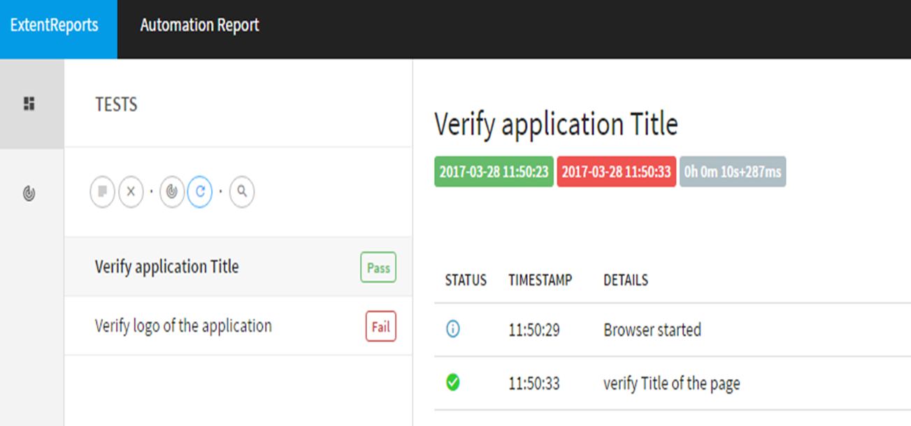
Example Output

Slide 118
Data Driven Testing

Slide 119
What is Data Driven Testing?
Data driven testing (DDT) is a term used in the testing of computer software to describe testing done using a table of conditions directly as test inputs and verifiable outputs as well as the process where test environment settings and control are not hard-coded.
In short:
Read data from a file
Use data as inputs for test
Output results to same/different file

Slide 120

Forms of DDT
IO Libraries (BufferedReader/Writer etc.) to read/write to files.
Certain Libraries such as Apache POI allow easy DDT
Poor Obfuscation Implementation file system
This library lets easily read/write to Microsoft Office file formats.
POI is great as Excel is great for DDT.
Pre-formatted
Easy to read
Easy to use

Slide 121
Good practices - Constants
Having a separate file for important variables is good practice.
Reusability
Readability
Script maintenance
public class Constant {
public static final String URL1 = "http://php.thedemosite.co.uk/addauser.php";
public static final String URL2 = "http://php.thedemosite.co.uk/login.php";
public static final String Path_TestData = "C://Users//USERNAME//workspace//SeleniumTestWithDD//src//testData//";
public static final String File_TestData = "TestData.xlsx";
}

Slide 122
Obtaining Apache POI
In order to use Apache POI you will need to import the correct dependency.
Poi-ooxml works with the latest .xlsx Documents.
Poi will only work with older .xls documents.
<dependency>
<groupId>org.apache.poi</groupId>
<artifactId>poi-ooxml</artifactId>
<version>3.17</version>
</dependency>

Slide 123
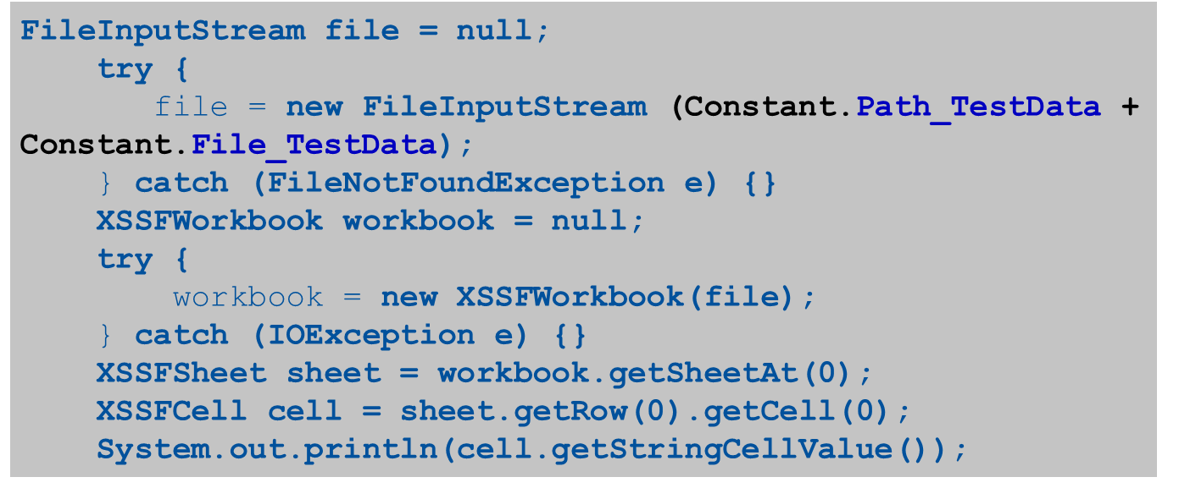
Apache POI - Example

Slide 124
Behaviour Driven Development (BDD)
Notes:
Ask what a user story looks like.
Ask why it is important/useful

Slide 125
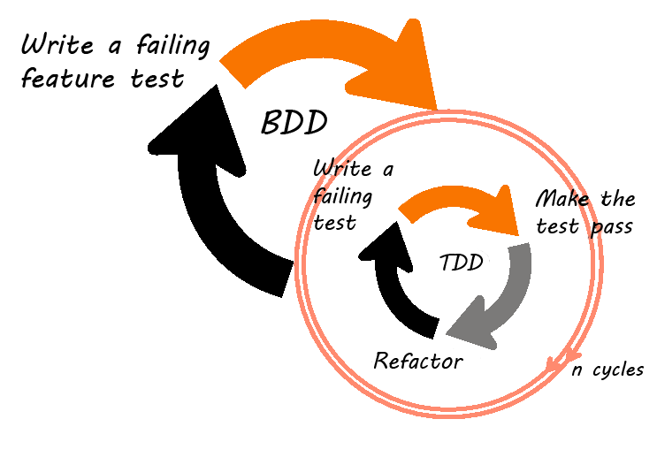
BDD - Definition
BDD is a set of best practices for writing great tests. BDD can, and should be, used together with TDD and unit testing methods.
Notes:
Ask what TDD looks like

Slide 126
Principles
Is a refinement of TDD and Acceptance Driven Development (ATDD)
Apply the "Five Why's" principle to each proposed user story, so that its purpose is clearly related to business outcomes
Thinking "from the outside in", in other words implement only those behaviours which contribute most directly to these business outcomes, so as to minimize waste
Describe behaviours in a single notation which is directly accessible to domain experts, testers and developers, so as to improve communication
Apply these techniques all the way down to the lowest levels of abstraction of the software, paying particular attention to the distribution of behaviour, so that evolution remains cheap
This means that all development work can be traced back directly to the business objectives.

Slide 127
The Five Why’s
5 Whys is an iterative interrogative technique used to explore the cause-and-effect relationships underlying a particular problem.
The vehicle will not start. (the problem)
1. Why? - The battery is dead.
2. Why? - The alternator is not functioning.
3. Why? - The alternator belt has broken.
4. Why? - The alternator belt was well beyond its useful service life and not replaced.
5. Why? - The vehicle was not maintained according to the recommended service schedule.

Slide 128
Benefits of BDD
BDD offers more precise guidance on organizing the conversation between developers, testers and domain experts
Notations originating in the BDD approach, in particular the given-when-then canvas, are closer to everyday language and have a shallower learning curve compared to those of other tools
Tools targeting a BDD approach generally afford the automatic generation of technical and end user documentation from BDD "specifications"

Slide 129
BDD Tool
We will be using the Cucumber software tool
It utilises a plain language parser called Gherkin.
Written in Ruby
It is designed to run automated Tests in a BDD style.

Slide 130
Cucumber
Allows the easy creation of specific tests with the collaboration of multiple members of a team.
Such as Testers, Developers and Business Analysists.
Used with multiple Languages – we will be using it with Java

Slide 131
How it works
Works using two files:
1. A Feature File
2. A Step Definition File
We will also be using a Test Runner in order to run our .feature file.

Slide 132
Feature file
A feature file is the main part of Cucumber.
It works using a specific notation called Given-When-Then.
It is very similar to the notation used in a user story, i.e. As a X-I want to Y-So that Z
It is not a .txt file, but actually a .feature file.

Slide 133
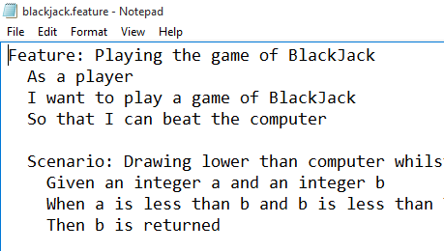
Feature file

Slide 134
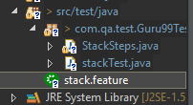
Feature File
A feature file Is built up of several layers
The first being the Feature that is being tested
This is written like so:
Feature: [The Feature to be tested]
Feature files are placed into the project structure like so:

Slide 135
Feature File
The second part is made up of the individual scenarios
The scenarios are the different paths that can be taken within the feature.
They are written like so:
Scenario: [Scenario to be tested]

Slide 136
Feature File
The final part of a feature file is the contents of the Scenario
This forms what we are going to test in this feature.
This is written using Given-When-Then notation
Which is written like the following:
Given I want to go to www.google.com
When I search for QA
Then a link to www.qa.com should be visible

Slide 137
Feature file example
Feature: [The Feature to be tested]
Scenario: [Scenario to be tested]
Given I want to go to www.google.com
When I search for QA
Then a link to www.qa.com should be visible

Slide 138
Feature file example - additional
Given an empty stack
When I push an item into the stack
And I push another item into the stack
Then the stack contains two items

Slide 139
Feature File
A final note about feature files is that they can contain multiple scenarios
However you should not put lots of scenarios in one file as it would soon become unreadable.
The ‘5 Whys’ gives you an indication of how many scenarios you should be doing.

Slide 140
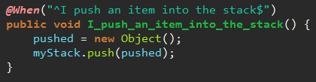
Step Definition File
The Step definition file is a class/file within your programming language that holds what’s known as the ‘glue’ code
This is where we translate the steps from our feature file into code that we can use to perform the tests.
You can also go to the Eclipse Marketplace and install the Cucumber Plugin, this will make running your feature files much easier.

Slide 141
Cucumber and Step Definition Files
In order to start using Cucumber you will need 2 dependencies
<dependency>
<groupId>info.cukes</groupId>
<artifactId>cucumber-java</artifactId>
<version>1.2.4</version>
<scope>test</scope>
</dependency>
<dependency>
<groupId>info.cukes</groupId>
<artifactId>cucumber-junit</artifactId>
<version>1.2.4</version>
<scope>test</scope>
</dependency>

Slide 142
Test Runner
A Test Runner will describe the harness we are using to run our tests
@RunWith(Cucumber.class)
@CucumberOptions(features = "classpath:")
public class testRunner {
}

Slide 143
Thank you
QA hopes you enjoyed your course,
as much as we enjoyed teaching you.

